Slide 1
Innovations & Best Practices
GLCA Presidential Summit on Mental Health and Wellness
December 12, 2019

Slide 2
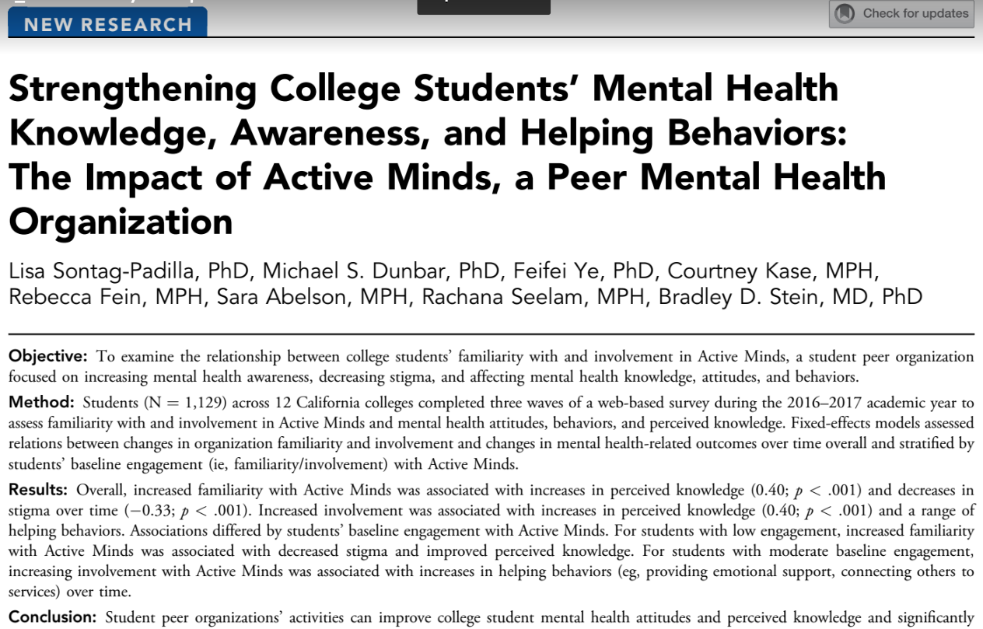

Slide 3
Policy and Systems Change Trends among Student Advocates
Funding and resources for mental health services (45%)
Requiring inclusion of counseling center resources on ID cards, syllabi, dormitories, etc. (28%)
Integration of mental health into first-year experiences (21%)
Leave of absence policies (5%)
Training for key stakeholders on campus (3%)
Reduction in means of suicide (1%)
www.activeminds.org/transform

Slide 4
Active Minds Healthy Campus Award Criteria:
Collective, strategic approach
Pursue health comprehensively
Champion student voices
Provide equal opportunities for health
Provide responsive, accessible clinical services
Enact policy and systems change
Make the most of available resources
Measure results to drive change
Address emerging issues
www.activeminds.org/award

Slide 5
For more information:
Laura Horne, MPH, CHES Chief Program Officer Active Minds laura@activeminds.org www.activeminds.org

